Slide 1
Session “PowerPoint“

Slide 2
Rule #1 - Structure
A clear structure is important for the
processing and
understanding
of information

Slide 3
Rule #2 – Emphasis of content
Empty space can be used to emphasize content
Empty space can be used to emphasize content
Empty space can be used to emphasize content
Empty space can be used to emphasize content
Empty space can be used to emphasize content
Empty space can be used to emphasize content
Empty space can be used to emphasize content

Slide 4
Rule #3 – Framing, Color, Size
The importance of an element can be emphasized by framing, color and size

Slide 5
Rule #4 - Grid
The layout of a page can usually be defined by a grid which functions as the basis for all arrangements of elements on the page

Slide 6
Rule #5 - Colors
The legibility of texts is dependent on the colors selected.

Slide 7
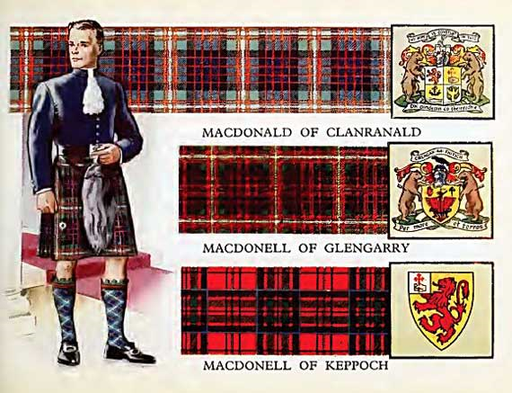
Rule #6 – Colors 2
Color can convey cultural and emotional information

Slide 8
Rule #7 – Word Art
Typefaces can be used to influence the interpretation of a text

Slide 9
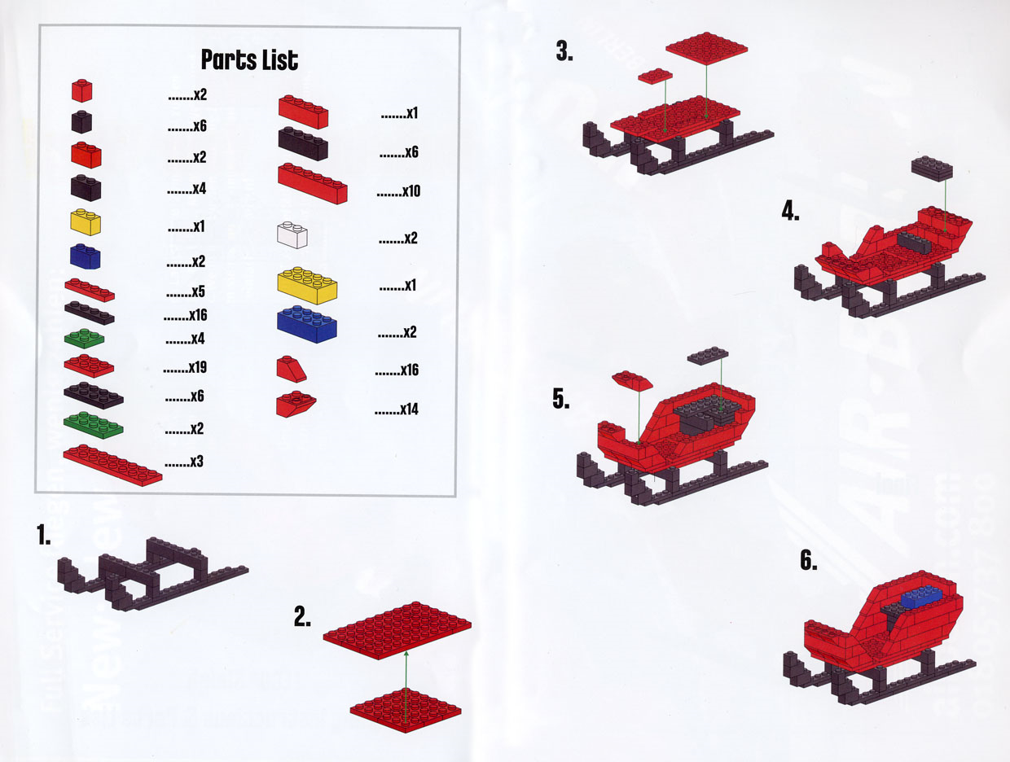
Rule # 8 - Diagrams
Diagrams can be used to display complex information in an understandable way

Slide 10
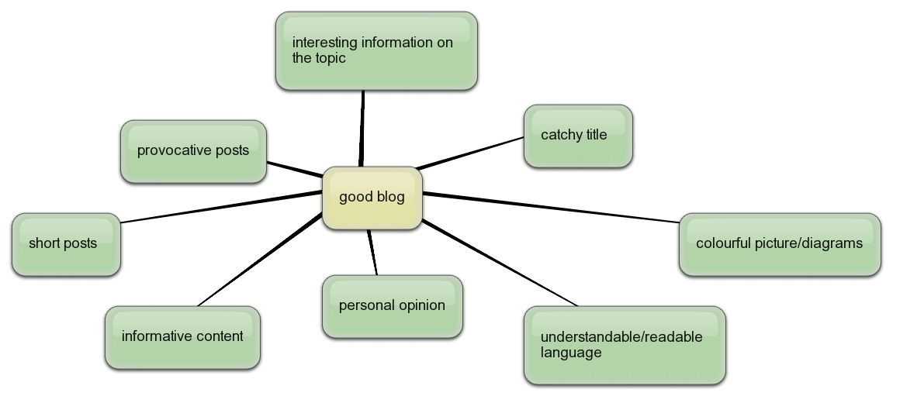
Rule # 9 – Multimedia
Multimedia elements can be used to visualize content that cannot be described by textual information

Slide 11
Rule # 10 - Animations
Animation can be used to direct attention

